Slide 1
Multiple Linear Regression & Logistic Regression on the Iris Dataset
Course: Data Mining STQM-342
Student: Caden Raleigh

Slide 2
Business Understanding
Goal: use flower measurements to model and predict iris characteristics.
Regression goal: predict Petal_length from other measurements.
Classification goal: predict Species_name (Setosa, Versicolor, Virginica).
Measure of success: valid models with high R² / classification accuracy and minimal overfitting.

Slide 3
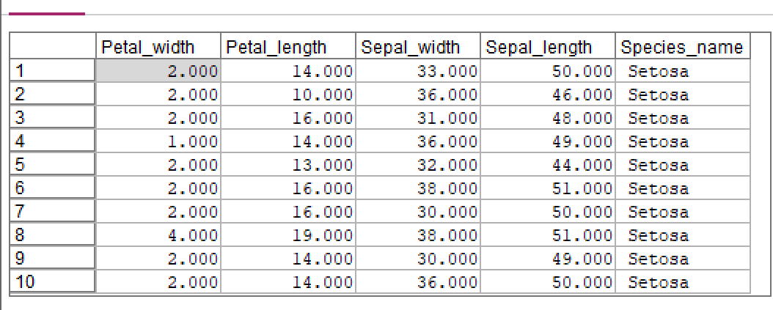
Data Understanding – Iris Dataset
Dataset: classic Fisher Iris data (150 flowers).
3 species: Setosa, Versicolor, Virginica (50 records each).
Continuous variables: Petal_length, Petal_width, Sepal_length, Sepal_width.
No missing values in the dataset.

Slide 4
MLR Setup – Variables & Roles
Target (Y): Petal_length (continuous).
Inputs (X): Petal_width, Sepal_width, Sepal_length (continuous).
Species fields were not used in MLR because they are categorical labels, not numeric predictors.
Data used in original measurement units (no Z-scores for MLR).

Slide 5
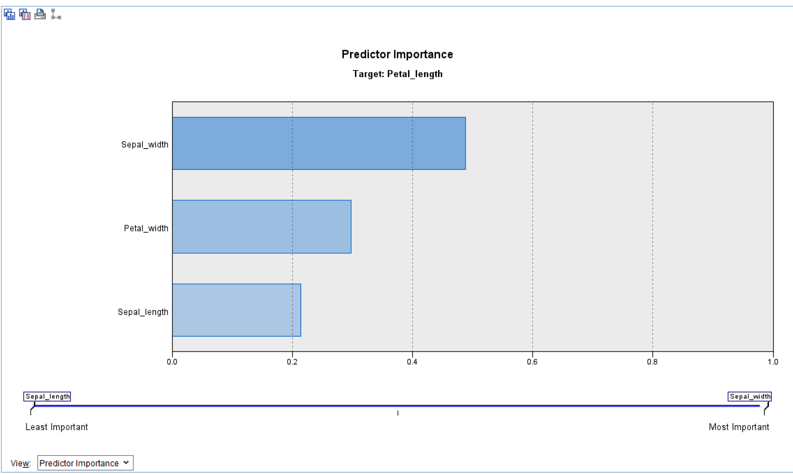
MLR – Correlation & Rationale
Strong linear relationships were observed between Petal_length and the other measurements.
High correlations justify using multiple linear regression to model Petal_length.

Slide 6
MLR – Model Building Strategy
Used stepwise multiple linear regression in SPSS Modeler.
Start with Petal_width, then add Sepal_length and Sepal_width as long as they significantly improve the model.
Data partition: 90% training, 10% testing to check for overfitting.
Final stepwise model retained all three predictors.

Slide 7
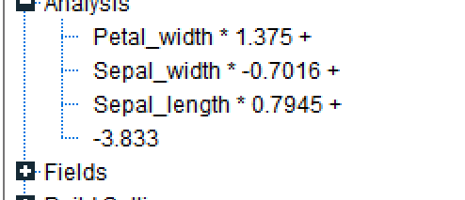
MLR – Final Regression Equation
Final stepwise MLR model (original units):
Petal_length = -3.833 + 1.375 × Petal_width + 0.795 × Sepal_length − 0.702 × Sepal_width
Interpretation example: holding other variables constant, a 1-unit increase in Petal_width increases expected Petal_length by about 1.375 units.
coefficients 1.375, 0.795, −0.702, and constant −3.833]

Slide 8
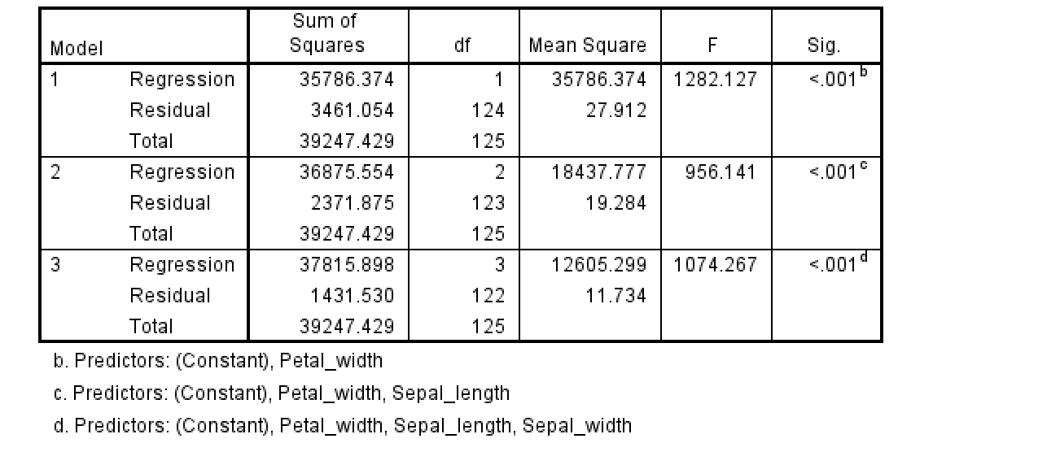
MLR – ANOVA & Overall Model Validity
Hypotheses: H₀: all slope coefficients β = 0 vs H₁: at least one β ≠ 0.
ANOVA F-test Sig < 0.001 < α = 0.05.
Conclusion: reject H₀ – the overall regression model is statistically significant.

Slide 9
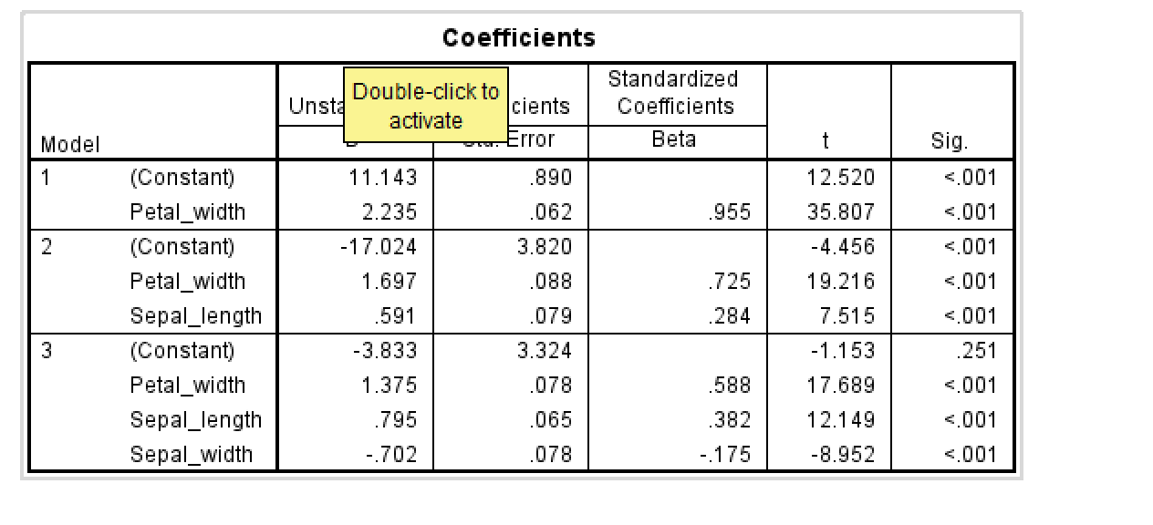
MLR – Coefficient Significance
All three predictors (Petal_width, Sepal_length, Sepal_width) have p-values < 0.001.
Each predictor contributes significantly to explaining Petal_length when controlling for the others.
The constant (intercept) is not practically important by itself but is needed for the line’s position.

Slide 10
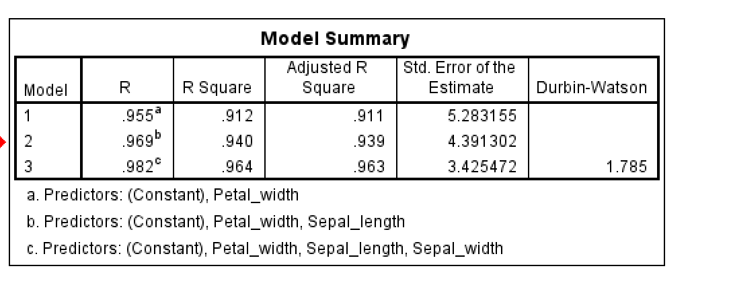
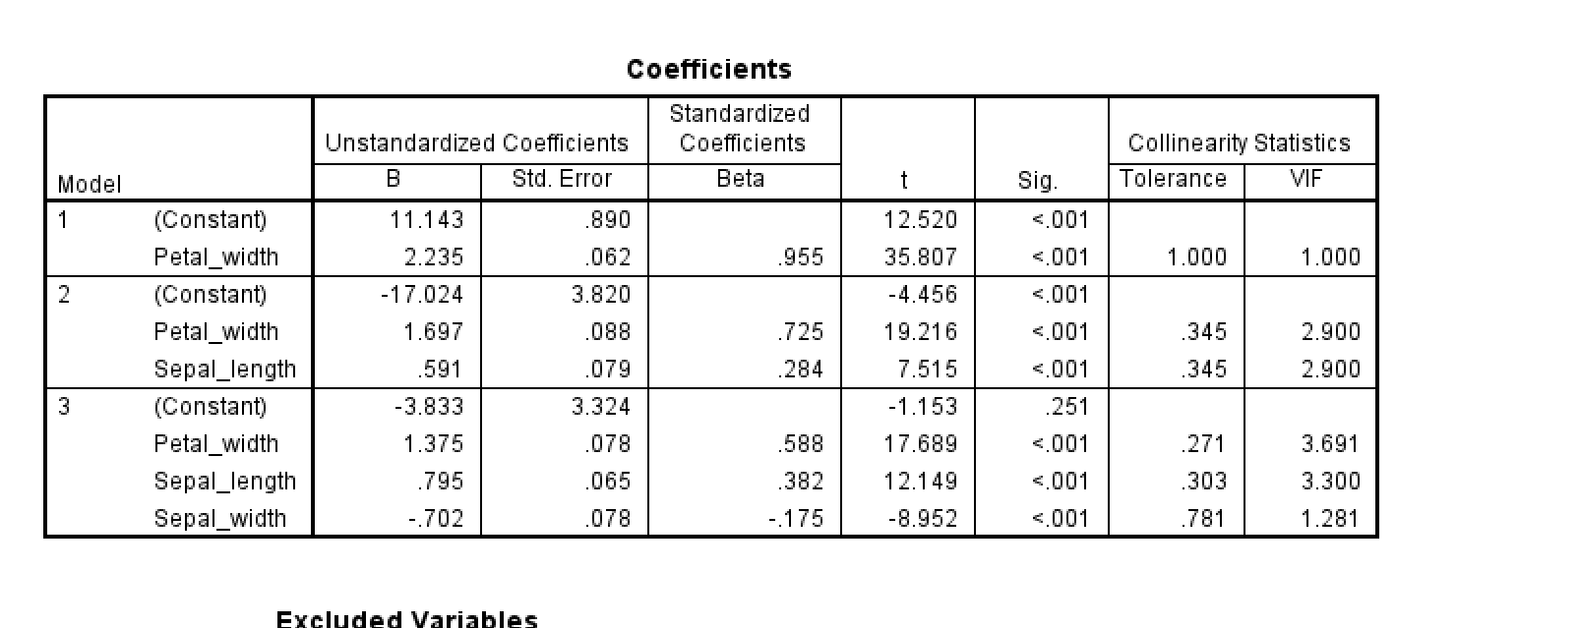
MLR – Multicollinearity & Independence
Variance Inflation Factor (VIF) values: all < 5 (and < 10).
→ No serious multicollinearity problems among the inputs.
Durbin–Watson statistic = 1.785, which lies between 1.5 and 2.5.
→ No evidence of problematic autocorrelation in residuals.

Slide 11
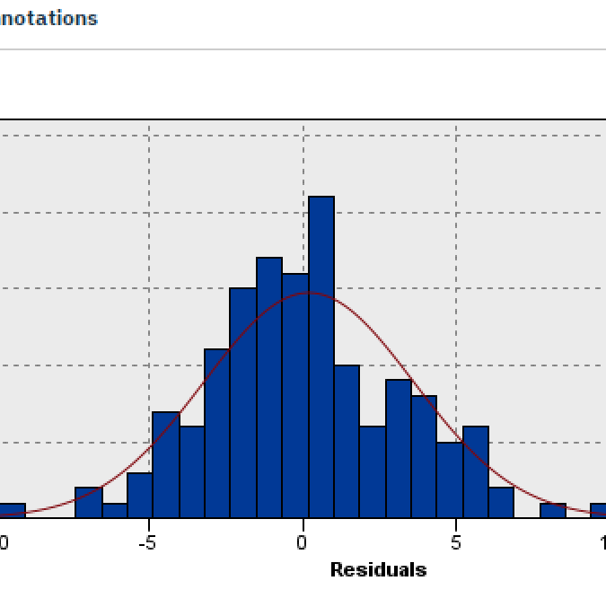
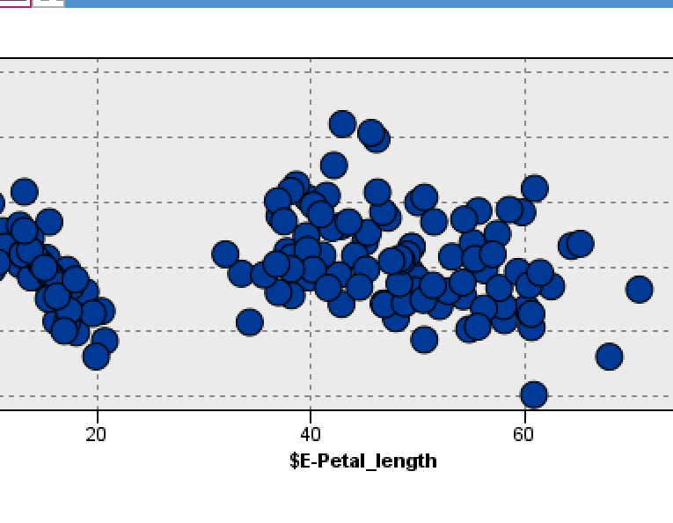
MLR – Residual Diagnostics
Residuals vs. predicted Petal_length: roughly constant spread around 0 with no strong pattern.
→ Supports assumption of constant variance (homoscedasticity).
Histogram of residuals: approximately bell-shaped but not perfectly normal.
→ Errors are close to normal; minor deviations are acceptable for large-sample regression.

Slide 12
MLR – Performance & Overfitting
Training R² ≈ 96.03% indicates that about 96% of the variation in Petal_length is explained by the three predictors.
Testing performance ≈ 95.83%, giving an overfit of about 0.2%.
→ The model generalizes very well to new data and is not overfitted.
MLR provides an accurate and interpretable summary of how petal and sepal measurements affect Petal_length.

Slide 13
MLR Assumptions
Assumptions of Multiple Linear Regression
Linear relationship between predictors and Petal_length
Independent errors (Durbin-Watson = 1.785)
Residuals approximately normal
Constant variance in residuals (no clear funneling)
No multicollinearity (all VIF < 5)
Adequate sample size for 3 predictors

Slide 14
From Regression to Classification
Next, the focus shifts from predicting a continuous outcome to predicting the flower species.
Logistic regression is used because the target variable Species_name is categorical with three classes.
A multinomial logistic procedure is required (binary logistic is not sufficient for 3 categories).

Slide 15
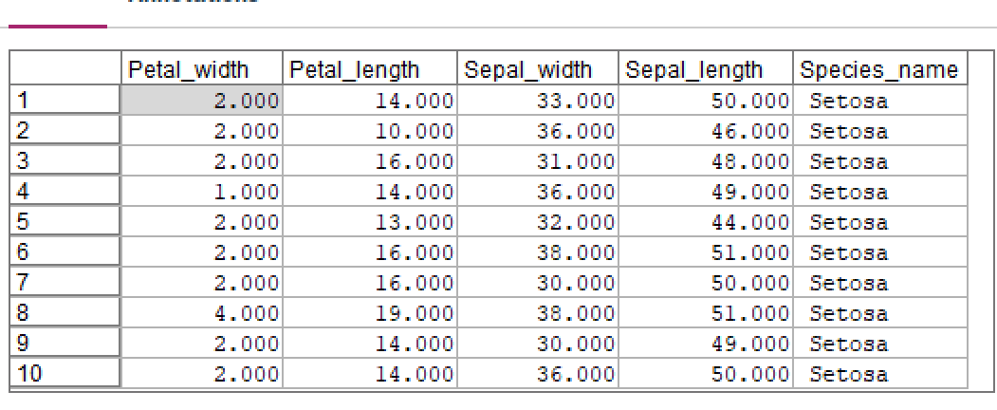
Logistic Regression Setup
Target: Species_name (Setosa, Versicolor, Virginica).
Inputs: Petal_width, Petal_length, Sepal_width, Sepal_length (original units).
Partition: same 90% training / 10% testing split as MLR.
Multinomial logistic regression used with Setosa as the reference category.

Slide 16
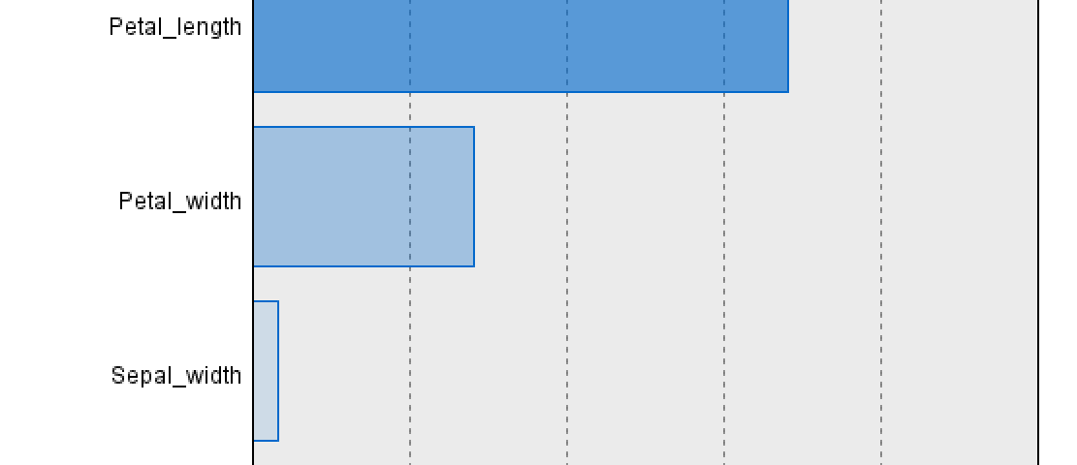
Logistic Regression – Predictor Importance
Predictor importance results for Species_name:
• Petal_length ≈ 0.68 (most important predictor).
• Petal_width ≈ 0.28 (second most important).
• Sepal_width ≈ 0.03 and Sepal_length ≈ 0.00 (minimal impact).
Conclusion: petal measurements dominate species classification.

Slide 17
Logistic Regression – Versicolor vs Setosa
Equation for log-odds of Versicolor (relative to Setosa):
log(P(Versicolor)/P(Setosa)) = 4.530 + 1.274×Petal_width + 0.990×Petal_length − 0.464×Sepal_width − 0.492×Sepal_length.
Exp(B) (odds ratios) interpretation:
• Petal_width Exp(B) ≈ 3.576 → each 1-unit increase multiplies odds of Versicolor vs Setosa by about 3.6.
• Petal_length Exp(B) ≈ 2.692 → each 1-unit increase multiplies odds by about 2.7.

Slide 18
Logistic Regression – Virginica vs Setosa
Equation for log-odds of Virginica (relative to Setosa):
log(P(Virginica)/P(Setosa)) = −23.024 + 2.232×Petal_width + 1.571×Petal_length − 0.676×Sepal_width − 0.662×Sepal_length.
Key odds ratios Exp(B):
• Petal_width Exp(B) ≈ 9.320 → very strong effect: larger petal width greatly increases odds of Virginica.
• Petal_length Exp(B) ≈ 4.810 → longer petals also strongly increase odds of Virginica.

Slide 19
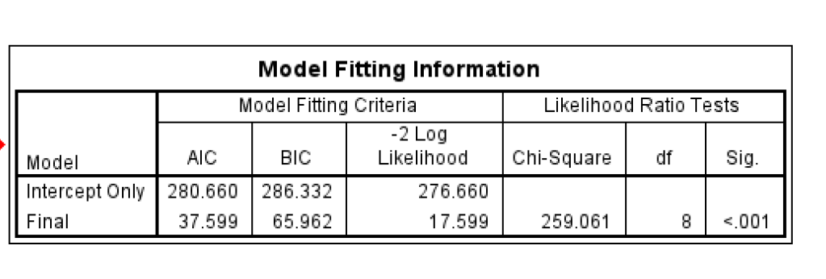
Logistic Regression – Overall Model Fit
Model fitting information:
• Intercept-only −2 Log Likelihood = 276.660.
• Final model −2 Log Likelihood = 17.599.
Chi-square = 259.061 with df = 8, Sig < 0.001.
Conclusion: the set of predictors significantly improves fit over the null model; the logistic model is valid.

Slide 20
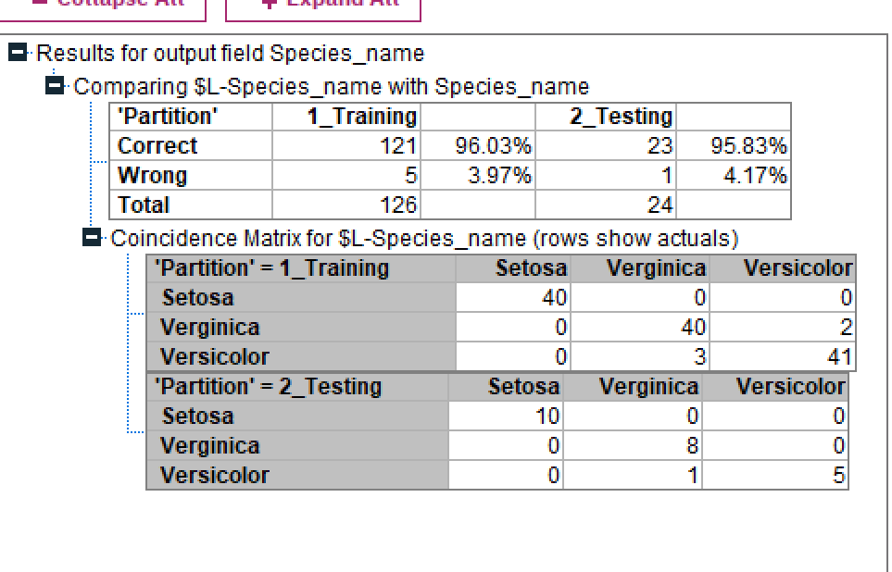
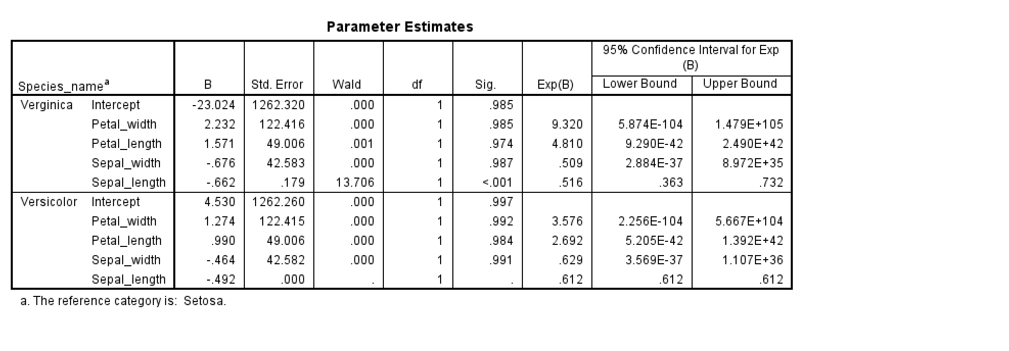
Logistic Regression – Pseudo R² & Overfitting
Pseudo R-Square (Nagelkerke) = 0.981.
→ About 98.1% of the variance in species membership is explained by the four inputs.
Classification accuracy: training ≈ 96.03%, testing ≈ 95.83%, overfit ≈ 0.2%.
Forward selection produced a slightly higher overfit (~0.59%), so the Enter / backward models were preferred.

Slide 21
Logistic Regression Assumptions
Assumptions of Logistic Regression
Target must be categorical (ours: 3-class species → multinomial)
Observations independent
Predictors not highly collinear (VIF < 5)
Linear relationship to log-odds for continuous predictors
Sufficient sample size (minimum ≈121, we exceeded with 150)
Model must fit better than intercept-only (Chi-Square Sig < .001)

Slide 22
Final Conclusions & Recommendations
Multiple Linear Regression:
• Petal_width, Sepal_length, and Sepal_width significantly predict Petal_length.
• Model explains ~96% of variance with minimal overfitting and acceptable residual diagnostics.
Logistic Regression:
• Petal_length and Petal_width are dominant predictors of species; sepal variables add little.
• Multinomial model is statistically valid (Chi-square p < .001) and explains 98.1% of species variation.
Overall: flower petal measurements contain nearly all of the useful information for both predicting petal length and classifying iris species.

